Slide 1
SER 334 A Session
SI Session
Monday, January 29th 2024
7:00 pm - 8:00 pm MST

Slide 2
{
Agenda
Memory
Structure
Interprocess Communication
Process Tracing
Module 5 Samples

Slide 3
SI Session Expectations
Thanks for coming to the SER 334 SI session. We have a packed agenda and we are going to try to get through as many of our planned example problems as possible. This session will be recorded and shared with others.
If after this you want to see additional examples, please visit the drop-in tutoring center.
We will post the link in the chat now and at the end of the session.
tutoring.asu.edu
Please keep in mind we are recording this session and it will be made available for you to review 24-48 hours after this session concludes.
Finally, please be respectful to each other during the session.

Slide 4

Interact with us:
Zoom Features
Zoom Chat
Use the chat feature to interact with the presenter and respond to presenter’s questions.
Annotations are encouraged

Slide 5
Memory
SER 334
Text
Memory
Which one holds dynamically allocated memory?
Data
Heap
Stack

Slide 6
Memory
SER 334
Text
Memory
Which one holds dynamically allocated memory?
Data
Heap
Stack

Slide 7
Memory
SER 334
Text
Memory
Which one holds our program code?
Data
Heap
Stack

Slide 8
Memory
SER 334
Text
Memory
Which one holds our program code?
Data
Heap
Stack

Slide 9
Memory
SER 334
Text
Memory
Which one holds global and static variables and objects?
Data
Heap
Stack

Slide 10
Memory
SER 334
Text
Memory
Which one holds global and static variables and objects?
Data
Heap
Stack

Slide 11
Memory
SER 334
Text
Memory
Which one holds temporary data?
Data
Heap
Stack

Slide 12
Memory
SER 334
Text
Memory
Which one holds temporary data?
Data
Heap
Stack

Slide 13
Memory
Module 5 Sample
SER 334
Text
Memory
1. [Acuña] There are four general regions to a process in memory: stack, heap, data, and text. List and explain which of these must be separated for each program running and which might be combined globally. (Don't worry about security or programs misbehaving.) [2 points]
Data
Heap
Stack

Slide 14
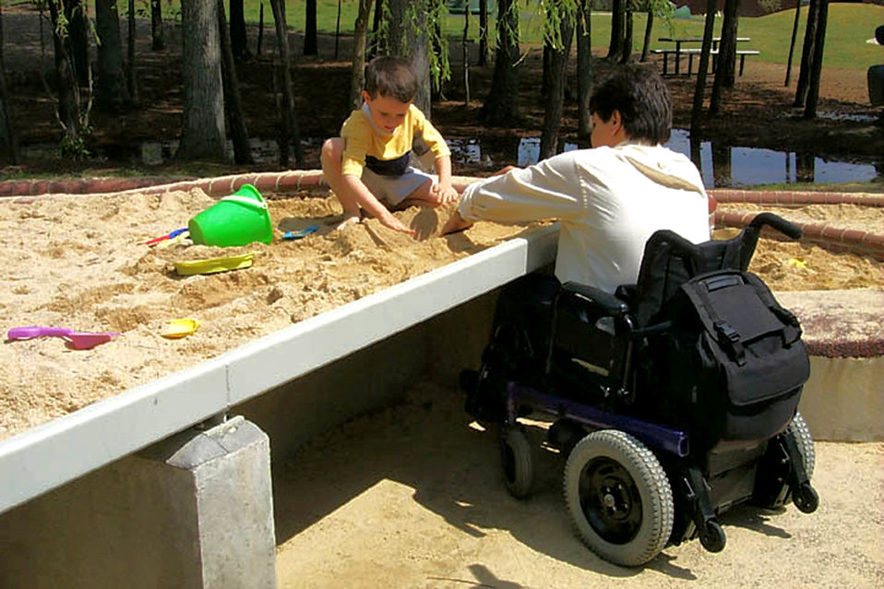
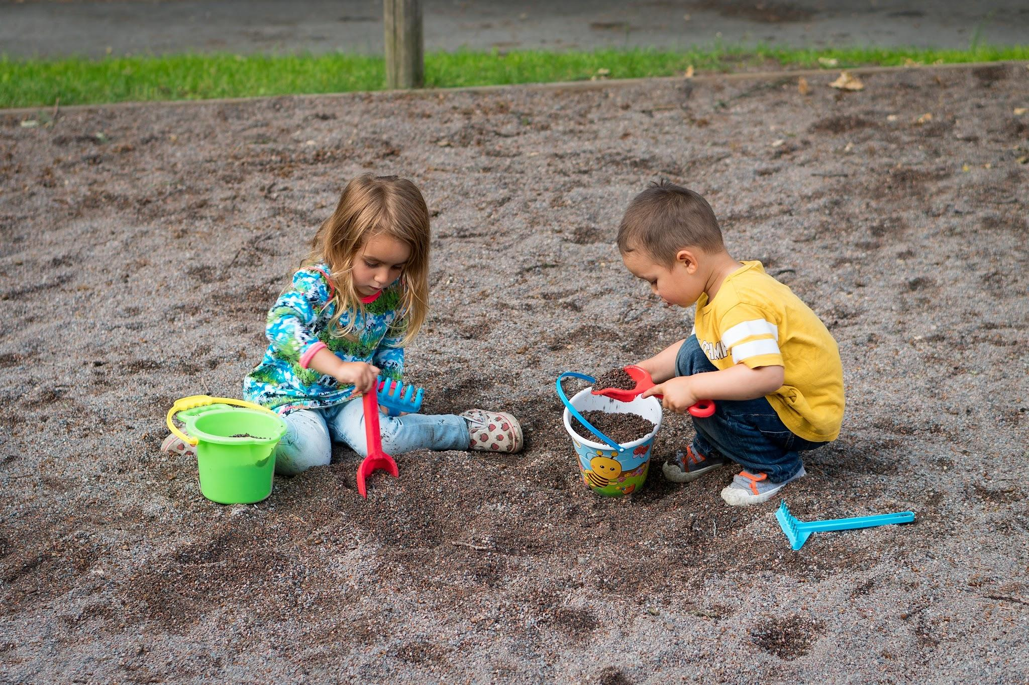
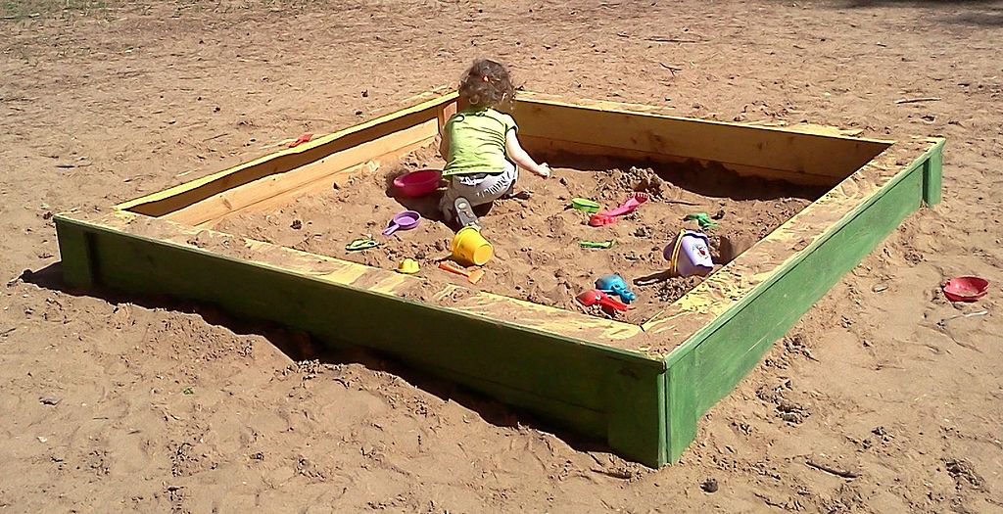
SER 334
Memory
Shared Memory
Message Passing
vs.
Notes:
Sharing a sandbox and tools vs my sandbox and your sand box with buddy moving between

Slide 15
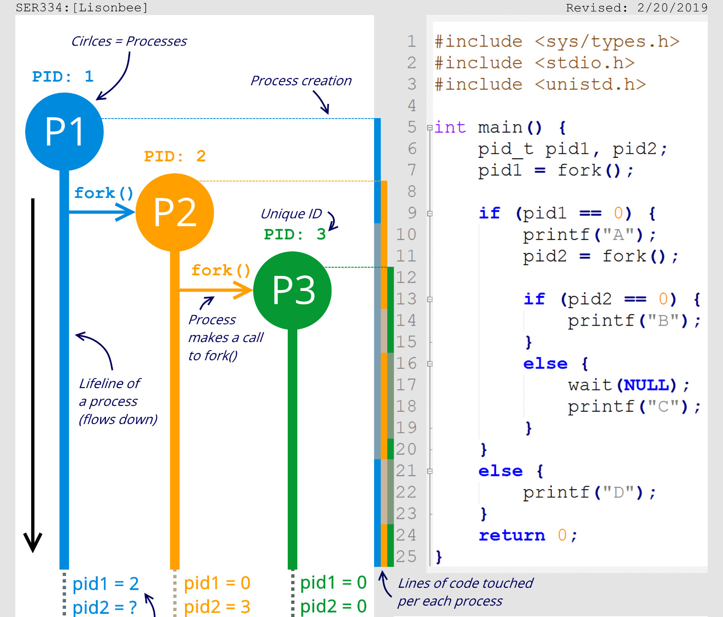
Module 5 Sample
SER 334
Processes
pid1
pid2
pid1
pid2
pid1
pid2
Output:
Notes:
What process are we in?

Slide 16
SER 334
Processes
pid1
2
Why 2?
pid2
pid1
0
Why 0?
pid2
0
pid1
pid2
Output:
Notes:
2 - we set the value of pid1 to the newly forked process, so we store the pid of the new process
0 - orange is Process 2, which was just created. CHILD PROCESS HAS ZERO AS PID

Slide 17
SER 334
Processes
pid1
2
pid2
pid1
0
pid2
0
pid1
pid2
A
Output:
Notes:
Where is pid zero? → child

Slide 18
SER 334
Processes
pid1
2
pid2
pid1
0
pid2
3
0
pid1
0
pid2
0
A
Output:
Notes:
Where is pid zero? → child

Slide 19
SER 334
Processes
pid1
2
pid2
pid1
0
pid2
3
pid1
0
pid2
0
A B
Output:
Notes:
So what’s running here? → all three processes
Process three will print b

Slide 20
SER 334
Processes
pid1
2
pid2
pid1
0
pid2
3
pid1
0
Which process printed “B”?
pid2
0
A B
Output:
Notes:
So what’s running here? → all three processes
Process three will print b

Slide 21
SER 334
Processes
pid1
2
pid2
pid1
0
pid2
3
?
pid1
0
pid2
0
A B
Output:
Notes:
What will execute this section?
Wait?? → parent must wait for child to finish!

Slide 22
SER 334
Processes
pid1
2
pid2
pid1
0
pid2
3
pid1
0
pid2
0
A B C
Output:
Notes:
What will execute this section?
Wait?? → parent must wait for child to finish!

Slide 23
SER 334
Processes
pid1
2
pid2
pid1
0
pid2
3
pid1
0
Which process printed “D”?
pid2
0
A B C D
Output:

Slide 24
Is that the only solution?
SER 334
Processes
pid1
2
pid2
pid1
0
pid2
3
pid1
0
pid2
0
A B C D
Output:
Notes:
Is that the only solution?

Slide 25
Is that the only solution?
SER 334
Processes
pid1
2
pid2
A
pid1
0
pid2
3
B C
pid1
0
pid2
0
D
A B C D
Output:
Notes:
Is that the only solution?

Slide 26
Is that the only solution?
SER 334
Processes
pid1
2
pid2
A
pid1
0
pid2
3
B C
pid1
0
pid2
0
D
A B C D
A D B C
D A B C
A B D C
Output:

Slide 27
Module 5 Sample
int main() {
pid_t temp1, temp2, temp3;
temp1 = fork();
if (temp1 < 0) { /* Error occurred */
fprintf(stderr, "Fork Failed");
return 1;
}
else if (temp1 == 0) { /* Process 2 */
temp2 = fork();
if (temp2 < 0) { /* Error occurred */
fprintf(stderr, "Fork Failed");
return 1;
}
else if (temp2 == 0) { /* Process 3 */
temp3 = getpid();
printf("temp2 = %d", temp2); /* A */
printf("temp3 = %d", temp3); /* B */
}
else { /* Process 2 */
temp3 = getpid();
printf("temp2 = %d", temp2); /* C */
printf("temp3 = %d", temp3); /* D */
wait(NULL);
}
}
else { /* Process 1 */
temp2 = getpid();
printf("temp1 = %d", temp1); /* E */
printf("temp2 = %d", temp2); /* F */
wait(NULL);
}
return 0;
}
temp1
SER 334
P1
1502
temp2
Module 5 Sample
4. [Lisonbee] Trace the program below, identify the values of the pids at lines A, B, C, D, E, and F.
(Assume that the actual pid of Process 1 is 1502, Process 2 is 1505, and Process 3 is 1507. Also assume that fork will always succeed.) [4 points]
temp3
temp1
P2
1505
temp2
A
B
C
D
E
F
temp3
temp1
P3
1507
temp2
temp3

Slide 28
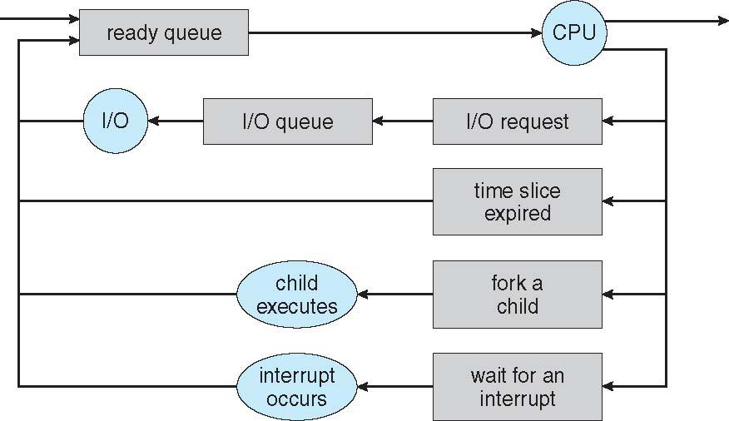
Module 5 Sample
3. [Bahremand] Explain why the queue diagram in slide 9 has a continuous cycle that flows between the listed queues and resources? Is a cycle necessary? [2 points]
SER 334
Enter topic here

Slide 29
Module 5 Sample
SER 334
Enter topic here
6. [Lisonbee] Consider a system where two processes (a producer and a consumer) use a message-passing system to communicate, and each process does work at different rates. The producer can produce (perform work) at any rate, but the consumer has to wait for the producer to complete its task before moving on. Based on this system's needs, explain whether a synchronous or asynchronous communication system would be a better choice and why. [2 points]
Synchronous
Asynchronous

Slide 30
SER 334
Scratch Space

Slide 31
Upcoming Events
SI Sessions:
Thursday, February 1st at 7:00 pm MST
Sunday, February 4th at 7:00 pm MST
Monday, February 5th at 7:00 pm MST
Review Sessions:
Exam 2 Review: TBD
Exam 3 Review: TBD

Slide 32

Questions?
Survey:
http://bit.ly/ASN2324

Slide 33


More Questions?
Check out our other resources!
tutoring.asu.edu
1-
2-
Click on ‘Go to Zoom’ to log onto our Online Tutoring Center.
Click on ‘View the tutoring schedule’ to see when tutors are available for specific courses.

Slide 34
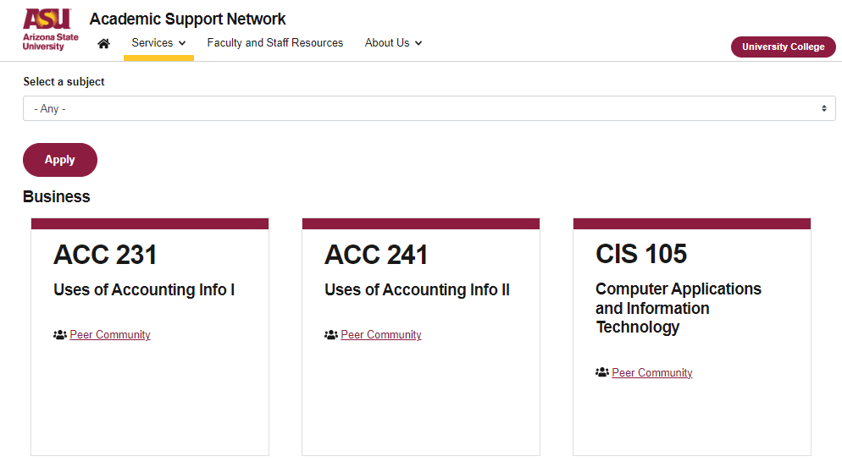

More Questions?
Check out our other resources!
tutoring.asu.edu/online-study-hub
Don’t forget to check out the Online Study Hub for additional resources!

Slide 35
Additional Resources
Course Repo
Course Discord
BMP File Format (Wiki)
Linux Kernel API
Bootlin - Linux Cross Referencer
Dining Philosophers Interactive

